Slide 1
Chapter 4: Threads

Slide 2
Chapter 4: Threads
Overview
Multicore Programming
Multithreading Models
Thread Libraries
Implicit Threading
Threading Issues
Operating System Examples

Slide 3
Objectives
To introduce the notion of a thread—a fundamental unit of CPU utilization that forms the basis of multithreaded computer systems
To discuss the APIs for the Pthreads, Windows, and Java thread libraries
To explore several strategies that provide implicit threading
To examine issues related to multithreaded programming
To cover operating system support for threads in Windows and Linux

Slide 4
Motivation
Most modern applications are multithreaded
Threads run within application
Multiple tasks with the application can be implemented by separate threads
  Update display
  Fetch data
  Spell checking
  Answer a network request
Process creation is heavy-weight while thread creation is light-weight
Can simplify code, increase efficiency
Kernels are generally multithreaded

Slide 5

Single and Multithreaded Processes

Slide 6
Benefits
Responsiveness – may allow continued execution if part of process is blocked, especially important for user interfaces
Resource Sharing – threads share resources of process, easier than shared memory or message passing
Economy – cheaper than process creation, thread switching lower overhead than context switching
Scalability – process can take advantage of multiprocessor architectures

Slide 7
Multicore Programming
Multicore systems putting pressure on programmers, challenges include:
  Dividing activities
  Balance
  Data splitting
  Data dependency
  Testing and debugging
Types of parallelism
  Data parallelism – distributes subsets of the same data across multiple cores, same operation on each
  Task parallelism – distributing threads across cores, each thread performing unique operation
As # of threads grows, so does architectural support for threading
  CPUs have cores as well as hardware threads
  Consider Oracle SPARC T4 with 8 cores, and 8 hardware threads per core

Slide 8

Multithreaded Server Architecture

Slide 9
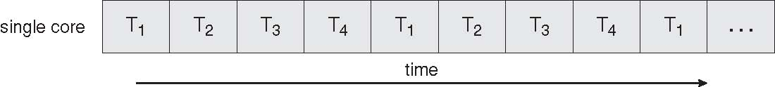
Concurrent Execution on a
Single-core System

Slide 10
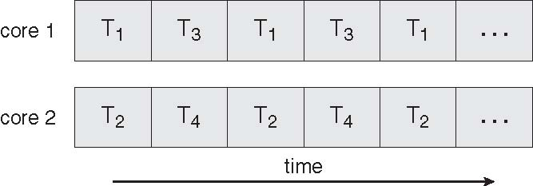
Parallel Execution on a
Multicore System

Slide 11
User Threads and Kernel Threads
User threads - management done by user-level threads library
Three primary thread libraries:
  POSIX Pthreads
  Windows threads
  Java threads
Kernel threads - Supported by the Kernel
Examples – virtually all general purpose operating systems, including:
  Windows
  Solaris
  Linux
  Tru64 UNIX
  Mac OS X

Slide 12
Multithreading Models
Many-to-One
One-to-One
Many-to-Many

Slide 13
Many-to-One
Many user-level threads mapped to single kernel thread
Examples:
  Solaris Green Threads
  GNU Portable Threads

Slide 14
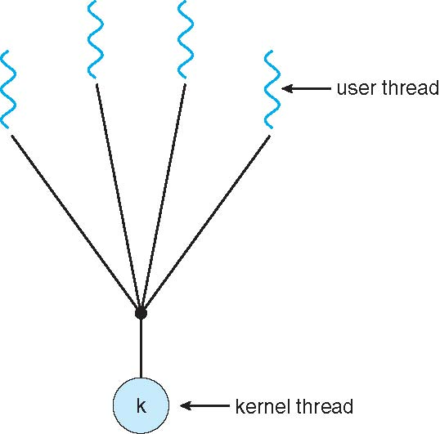
Many-to-One Model

Slide 15
One-to-One
Each user-level thread maps to kernel thread
Examples
  Windows NT/XP/2000
  Linux
  Solaris 9 and later

Slide 16
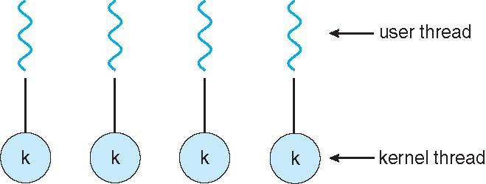
One-to-one Model

Slide 17
Many-to-Many Model
Allows many user level threads to be mapped to many kernel threads
Allows the operating system to create a sufficient number of kernel threads
Solaris prior to version 9
Windows NT and later with the ThreadFiber package

Slide 18

Many-to-Many Model

Slide 19
Two-level Model
Similar to M:M, except that it allows a user thread to be bound to kernel thread
Examples
  IRIX
  HP-UX
  Tru64 UNIX
  Solaris 8 and earlier

Slide 20
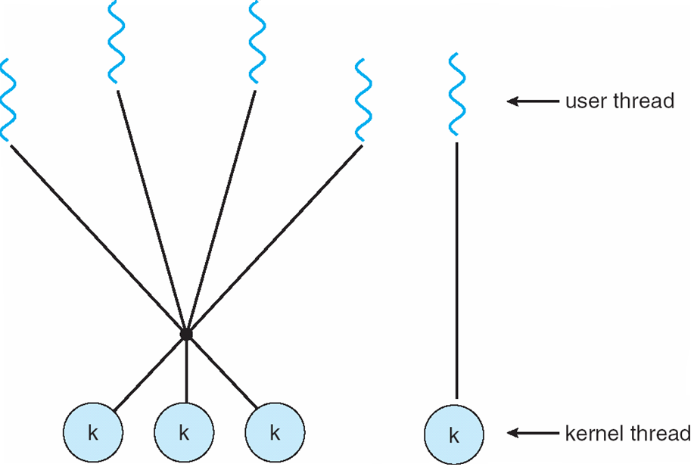
Two-level Model

Slide 21
Thread Libraries
Thread library provides programmer with API for creating and managing threads
Two primary ways of implementing
  Library entirely in user space
  Kernel-level library supported by the OS

Slide 22
Pthreads
May be provided either as user-level or kernel-level
A POSIX standard (IEEE 1003.1c) API for thread creation and synchronization
API specifies behavior of the thread library, implementation is up to development of the library
Common in UNIX operating systems (Solaris, Linux, Mac OS X)

Slide 23
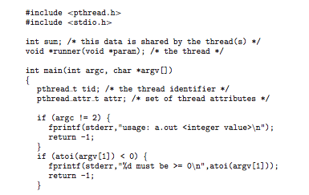
Pthreads Example

Slide 24
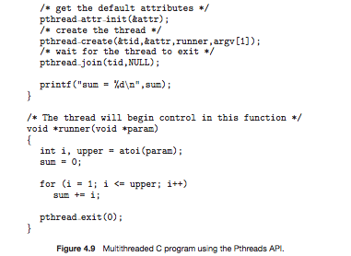
Pthreads Example (Cont.)

Slide 25
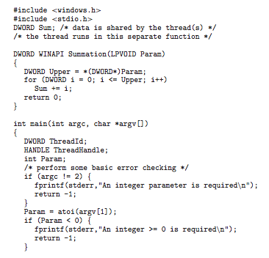
Win32 API Multithreaded C Program

Slide 26
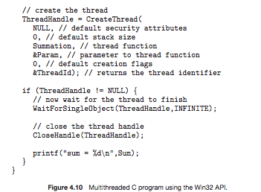
Win32 API Multithreaded C Program (Cont.)

Slide 27
Java Threads
Java threads are managed by the JVM
Typically implemented using the threads model provided by underlying OS
Java threads may be created by:
  Extending Thread class
  Implementing the Runnable interface

Slide 28
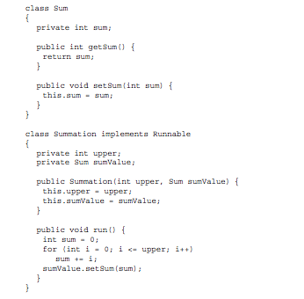
Java Multithreaded Program

Slide 29
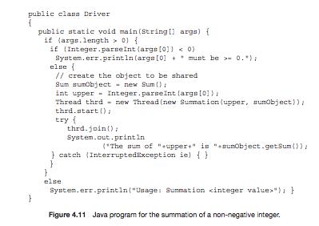
Java Multithreaded Program (Cont.)

Slide 30
Threading Issues
Semantics of fork() and exec() system calls
Thread cancellation of target thread
  Asynchronous or deferred
Signal handling
  Synchronous and asynchronous

Slide 31
Threading Issues (Cont.)
Thread pools
Thread-specific data
    Create Facility needed for data private to thread
Scheduler activations

Slide 32
Semantics of fork() and exec()
Does fork() duplicate only the calling thread or all threads?

Slide 33
Thread Cancellation
Terminating a thread before it has finished
Two general approaches:
  Asynchronous cancellation terminates the target thread immediately.
  Deferred cancellation allows the target thread to periodically check if it should be cancelled.

Slide 34
Signal Handling
Signals are used in UNIX systems to notify a process that a particular event has occurred.
A signal handler is used to process signals
  Signal is generated by particular event
  Signal is delivered to a process
  Signal is handled
Options:
  Deliver the signal to the thread to which the signal applies
  Deliver the signal to every thread in the process
  Deliver the signal to certain threads in the process
  Assign a specific thread to receive all signals for the process

Slide 35
Thread Pools
Create a number of threads in a pool where they await work
Advantages:
  Usually slightly faster to service a request with an existing thread than create a new thread
  Allows the number of threads in the application(s) to be bound to the size of the pool

Slide 36
Thread Specific Data
Allows each thread to have its own copy of data
Useful when you do not have control over the thread creation process (i.e., when using a thread pool)

Slide 37
Scheduler Activations
Both M:M and Two-level models require communication to maintain the appropriate number of kernel threads allocated to the application
Scheduler activations provide upcalls - a communication mechanism from the kernel to the thread library
This communication allows an application to maintain the correct number kernel threads

Slide 38

Lightweight Processes

Slide 39
Operating System Examples
Windows XP Threads
Linux Thread

Slide 40
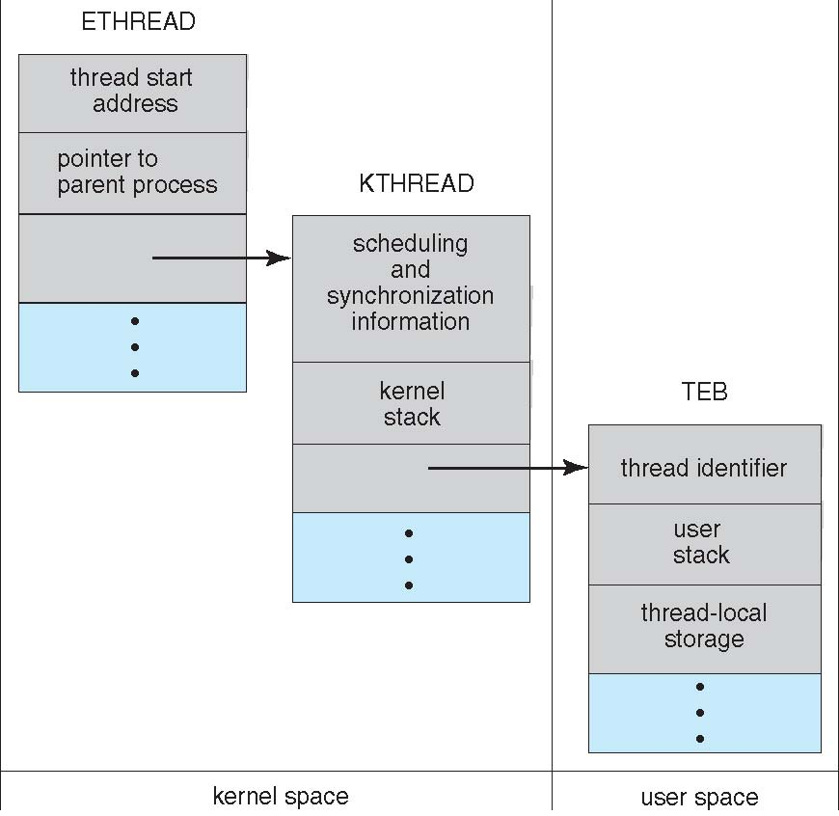
Windows XP Threads Data Structures

Slide 41
Windows XP Threads
Implements the one-to-one mapping, kernel-level
Each thread contains
  A thread id
  Register set
  Separate user and kernel stacks
  Private data storage area
The register set, stacks, and private storage area are known as the context of the threads
The primary data structures of a thread include:
  ETHREAD (executive thread block)
  KTHREAD (kernel thread block)
  TEB (thread environment block)

Slide 42
Linux Threads
Linux refers to them as tasks rather than threads
Thread creation is done through clone() system call
clone() allows a child task to share the address space of the parent task (process)
struct task_struct points to process data structures (shared or unique)

Slide 43
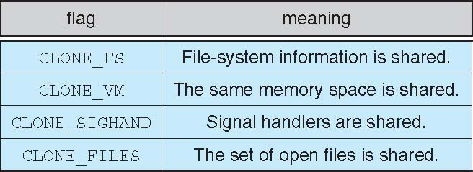
Linux Threads
fork() and clone() system calls
Doesn’t distinguish between process and thread
  Uses term task rather than thread
clone() takes options to determine sharing on process create
struct task_struct points to process data structures (shared or unique)

Slide 44
End of Chapter 4

